Slide 1

CSE 101 - COMPUTER PROGRAMMING I File
Joseph LEDET
Department of Computer Engineering
Akdeniz University
josephledet@akdeniz.edu.tr

Slide 2
Catching Exceptions
try {
statements; // Statements that may throw exceptions
}
catch (Exception1 exVar1) {
handler for exception1;
}
catch (Exception2 exVar2) {
handler for exception2;
}
...
catch (ExceptionN exVar3) {
handler for exceptionN;
}

Slide 3
The finally Clause
try {
statements;
}
catch(TheException ex) {
handling ex;
}
finally {
finalStatements;
}

Slide 4
The File Class
The File class is intended to provide an abstraction that deals with most of the machine-dependent complexities of files and path names in a machine-independent fashion. The filename is a string. The File class is a wrapper class for the file name and its directory path.

Slide 5
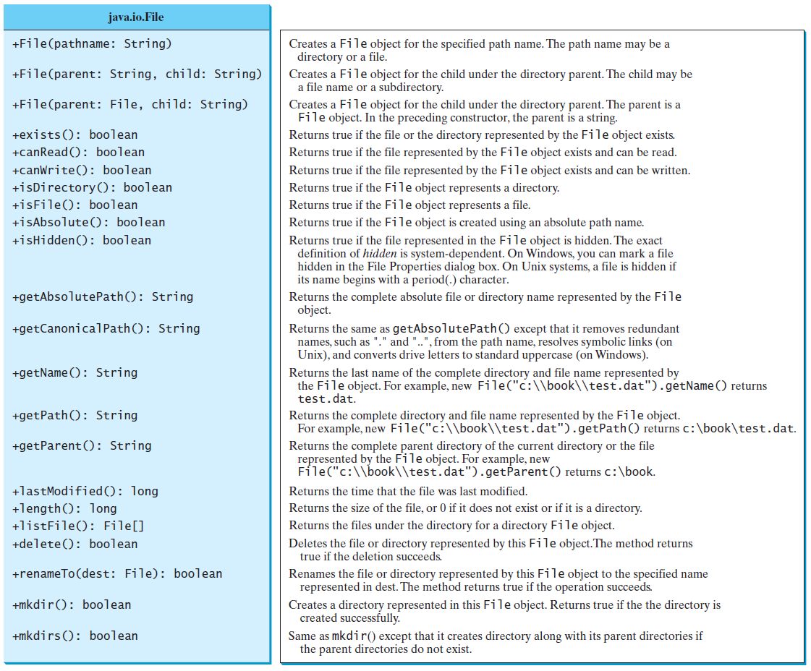
Obtaining file properties and manipulating file

Slide 6
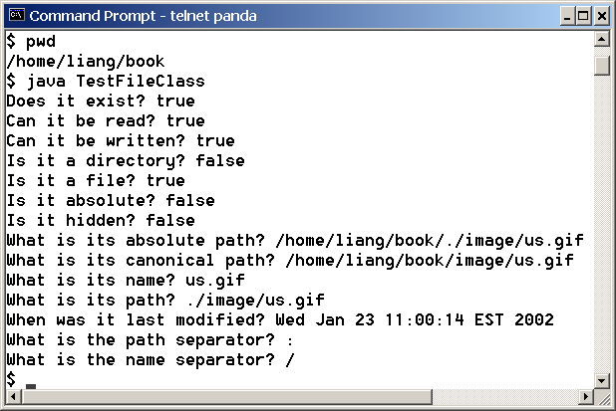
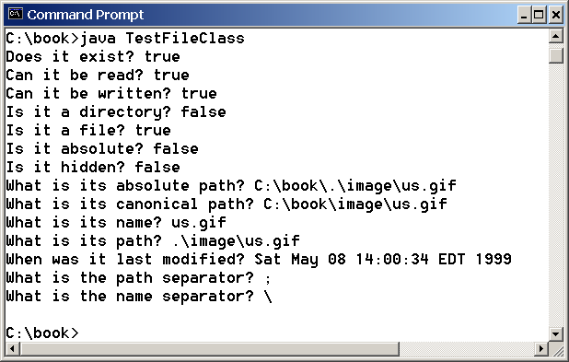
Problem: Explore File Properties
Objective: Write a program that demonstrates how to create files in a platform-independent way and use the methods in the File class to obtain their properties. The following figures show a sample run of the program on Windows and on Unix.
TestFileClass
Run

Slide 7
Text I/O
A File object encapsulates the properties of a file or a path, but does not contain the methods for reading/writing data from/to a file. In order to perform I/O, you need to create objects using appropriate Java I/O classes. The objects contain the methods for reading/writing data from/to a file. This section introduces how to read/write strings and numeric values from/to a text file using the Scanner and PrintWriter classes.

Slide 8
Writing Data Using PrintWriter
WriteData
Run

Slide 9
Try-with-resources
Programmers often forget to close the file. JDK 7 provides the followings new try-with-resources syntax that automatically closes the files.
try (declare and create resources) {
Use the resource to process the file;
}
WriteDataWithAutoClose
Run

Slide 10
Reading Data Using Scanner
ReadData
Run

Slide 11
Problem: Replacing Text
Write a class named ReplaceText that replaces a string in a text file with a new string. The filename and strings are passed as command-line arguments as follows:
java ReplaceText sourceFile targetFile oldString newString
For example, invoking
java ReplaceText FormatString.java t.txt StringBuilder StringBuffer
replaces all the occurrences of StringBuilder by StringBuffer in FormatString.java and saves the new file in t.txt.
ReplaceText
Run

Slide 12
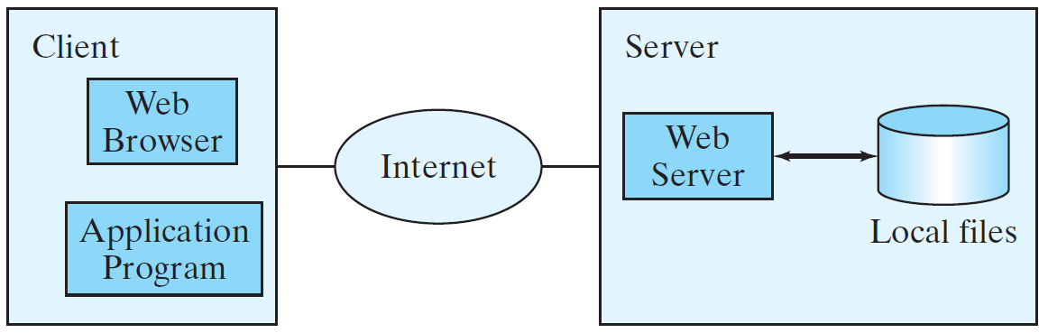
Reading Data from the Web
Just like you can read data from a file on your computer, you can read data from a file on the Web.

Slide 13
Reading Data from the Web
URL url = new URL("www.google.com/index.html");
After a URL object is created, you can use the openStream() method defined in the URL class to open an input stream and use this stream to create a Scanner object as follows:
Scanner input = new Scanner(url.openStream());
ReadFileFromURL
Run

